Slide 1
Natural Language Processing of Clinical Data
Natural Language Processing of Clinical Data
Giheon Koh
Ahmad Baghal, MD

Slide 2
INTRODUCTION
Electronic Medical Records (EMRs)
digital equivalent of paper records, or charts
typically contain general information such as treatment and medical history about a patient

Slide 3
INTRODUCTION
Concerns
With the rapid adoption of unstructured or free text formatted EMRs, it is desirable to extract accurate information from EMRs to support automated systems at the point of care and to enable secondary use of EMRs for clinical and translational research.
Natural Language Processing Tool has been developed to facilitate information extraction from the clinical free text.
Kavishwar B Wagholikar, Kathy L MacLaughlin, Michael R Henry, Robert A Greenes, Ronald A Hankey, Hongfang Liu, Rajeev Chaudhry, Clinical decision support with automated text processing for cervical cancer screening, Journal of the American Medical Informatics Association, Volume 19, Issue 5, September 2012, Pages 833–839,
Wang, Y., Wang, L., Rastegar-Mojarad, M., Moon, S., Shen, F., Afzal, N., … Liu, H. (2018). Clinical information extraction applications: A literature review. Journal of biomedical informatics, 77, 34–49. doi:10.1016/j.jbi.2017.11.011
Notes:
According to Laurie Miles [1], she mentioned, “About 75% of data is unstructured, coming from sources such as text, voice and video.”
Especially in clinical field, it is very important to extract as much information as possible to improve the quality of clinical procedures.

Slide 4
INTRODUCTION
What is Natural Language Processing?
“A branch of artificial intelligence that helps computers understand, interpret and manipulate human language”
What is Natural Language Processing? (n.d.). Retrieved July 9, 2019, from https://www.sas.com/en_us/insights/analytics/what-is-natural-language-processing-nlp.html

Slide 5
INTRODUCTION
Advantages and Challenge
Advantages
- Reduction of time for manual expert review
- High flexibility of secondary use of data for large scale automated processing
- Gaining more knowledge about patient information
Challenges
- poor structures, abundant shorthand, and domain-specific vocabularies → cause HIGH TEST ERROR RATE
Kreimeyer, K., Foster, M., Pandey, A., Arya, N., Halford, G., Jones, S. F., . . . Botsis, T. (17 july 2017). Natural Language Processing Systems for Capturing and Standardizing Unstructured Clinical Information. Journal of Biomedical Informatics,1-16. doi:10.1016

Slide 6
Important Concepts
Corpus
Corpus is a body of written or spoken material upon which a linguistic analysis is based.
London is the capital and most populous city of England, Great Britain, and the United Kingdom. Standing on the River Thames in the south eastern part of the island of Great Britain, London has been a major settlement for two millennia. It was founded by the Romans, who named it Londinium. …….
Notes:
Usually refers to samples.

Slide 7
Important Concepts
Tokenization
“London is the capital and most populous city of England and the United Kingdom.”
[“London”, “is”, “ the”, “capital”, “and”, “most”, “populous”, “city”, “of”, “England”, “and”, “the”, “United”, “Kingdom”, “.”]
Notes:
Idea : To process word recognition, splitting longer strings of text into smaller pieces, or tokens is needed

Slide 8
Important Concepts
Stop words
filtered out before further processing of text
contribute little to overall meaning
generally the most common words in a language.
[“London”, “is”, “ the”, “capital”, “and”, “most”, “populous”, “city”, “of”, “England”, “and”, “the”, “United”, “Kingdom”, “.”]
[“London”, “is”, “ the”, “capital”, “and”, “most”, “populous”, “city”, “of”, “England”, “and”, “the”, “United”, “Kingdom”, “.”]
Notes:
Stop words are those words which are filtered out before further processing of text, since these words contribute little to overall meaning, given that they are generally the most common words in a language. For instance, "the," "and," and "a,” …..

Slide 9
Important Concepts
Normalization
Mainly refers to:
Converting all text to the same case (uppercase or lowercase)
Removing punctuation
Expanding contractions
Converting numbers to their word equivalents
[“London” , “capital”, “most”, “populous”, “city”, “England”, “United”, “Kingdom”, “.”]
[‘london', 'capital’, “most”, 'populous', 'city', ‘england’, ‘united', ‘kingdom']
Notes:
Before further processing, text needs to be normalized. Normalization generally refers to a series of related tasks meant to put all text on a level playing field:
converting all text to the same case (upper or lower),
removing punctuation,
expanding contractions,
converting numbers to their word equivalents, and so on.
Normalization puts all words on equal footing, and allows processing to proceed uniformly

Slide 10
Important Concepts
stemming
Stemming is the process of eliminating affixes (suffixed, prefixes, infixes, circumfixes) from a word in order to obtain a word stem.
running → run automating → automat
operative → operat
[‘london', 'capital', “most”, 'populous', 'city', ‘england’, ‘united', ‘kingdom']
['london', 'capit', “most”, 'popul', 'citi', 'england', 'unit', 'kingdom']
Notes:
Stemming is the process of eliminating affixes (suffixed, prefixes, infixes, circumfixes) from a word in order to obtain a word stem.

Slide 11
Important Concepts
Lemmatization
Lemmatization is related to stemming, differing in that lemmatization is able to capture canonical forms based on a word's lemma.
better → good
worse → bad
diagnosis → diagnos
diagnoses → diagnosi
…
['london', 'capit', “most”, 'popul', 'citi', 'england', 'unit', 'kingdom']
['london', 'capit', “more”, 'popul', 'citi', 'england', 'unit', 'kingdom']

Slide 12
Important Concepts
Part-Of-Speech (POS) tagging
['london', 'capit’, ‘more’, 'popul', 'citi', 'england', 'unit', 'kingdom']
[('london', 'NN'), ('capit', 'NN’), (‘more’, ‘ADV’), ('popul', 'NN'), ('citi', 'NN'), ('england', 'VBP'), ('unit', 'NN'), ('kingdom', ‘NN)]
Notes:
POS tagging consists of assigning a category tag to the tokenized parts of a sentence.
The most popular POS tagging would be identifying words as nouns, verbs, adjectives, etc.

Slide 13
Procedure
Technologies applied
Python: - NLP requires Machine-Learning algorithms (b/c NLP needs automated processing of large-scale data)
- Python offers both NLP and ML packages
NLTK (Natural Language Tool Kit) :
- One of the widely used Python package for text mining
Notes:
The role of machine learning and AI in natural language processing (NLP) and text analytics is to improve, accelerate and automate the underlying text analytics functions and NLP features that turn unstructured text into useable data and insights.
For this research project, I mainly used Python because NLP requires machine-learning algorithms and Python offers both NLP and ML packages in one platform. The NLTK, Natural Language Tool Kit, is the most widely used NLP package in Python.

Slide 14
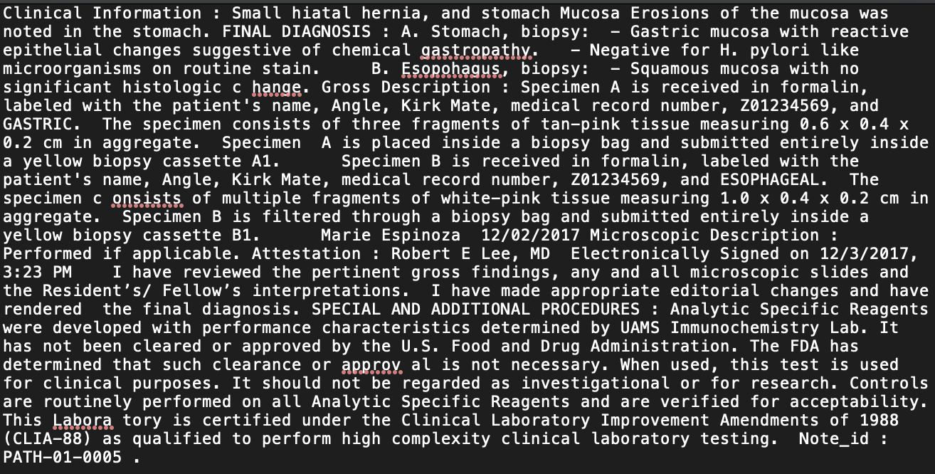
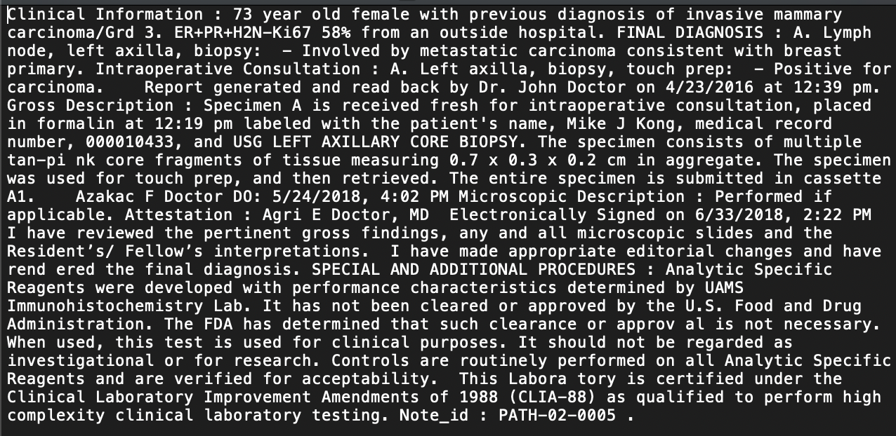
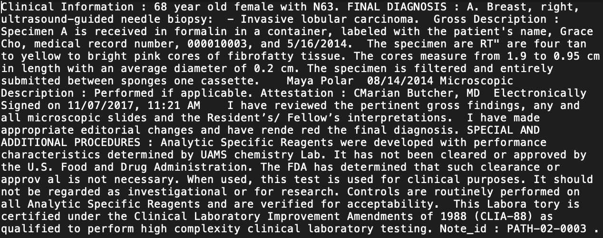
Procedure
Test Samples
20 deidentified Pathology report samples
. . .
Notes:
For the experiment, I used 20 deidentified pathology reports because the actual data are referring to the real patients’ information which are confidential.

Slide 15
Procedures
Workflow 1
1. Setting Stemming/Normalization standards and a list of stop words
2. Importing UMLS to train samples + Unified Medical Language System(UMLS) is a compendium of many controlled vocabularies in the biomedical sciences
3. Tokenized by words, filtered against stop words, and lemmatized
4. Part-of-Speech Tagging
5. Searching for cardinal quantity values ( from Part of Speech tagging)
- Because the numbers in text typically mean something. 6. Searching for gender information

Slide 16
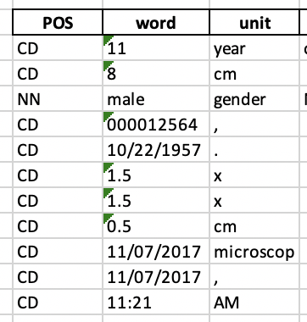
Half-way Result
Based on the Part-of-Speech,
the cardinal quantity and gender information
are extracted.
Notes:
Based on the Part-of-Speech, the cardinal quantity and gender information in the first sample are extracted.

Slide 17
Procedures
Workflow 2
Extracting :
strings for Final diagnosis - body part, clinical procedure information
- diagnosis grade information
patient’s diagnoses information and extract only important terms.

Slide 18
strings for Final diagnosis based on the section indicator
'… FINAL DIAGNOSIS : A. Cervix, biopsy: - At least high grade squamous intraepithelial lesion (CIN III) in a background of extensive necrosis, see comment. Comment : The specimen is predominately necrotic; however, there are small superficial fragments of severely dysplastic epithelium present. These findings are consistent with squamous cell carcinoma (unsampled) ...'
body part, clinical procedure information from the extracted strings
'… FINAL DIAGNOSIS : A. Cervix, biopsy: - At least high grade squamous intraepithelial lesion (CIN III) in a background of extensive necrosis, see comment. Comment : The specimen is predominately necrotic; however, there are small superficial fragments of severely dysplastic epithelium present. These findings are consistent with squamous cell carcinoma (unsampled) ...'
diagnosis grade information from the extracted strings
'… FINAL DIAGNOSIS : A. Cervix, biopsy: - At least high grade squamous intraepithelial lesion (CIN III) in a background of extensive necrosis, see comment. Comment : The specimen is predominately necrotic; however, there are small superficial fragments of severely dysplastic epithelium present. These findings are consistent with squamous cell carcinoma (unsampled) ...'
patient’s diagnoses information
'… FINAL DIAGNOSIS : A. Cervix, biopsy: - At least high grade squamous intraepithelial lesion (CIN III) in a background of extensive necrosis, see comment. Comment : The specimen is predominately necrotic; however, there are small superficial fragments of severely dysplastic epithelium present. These findings are consistent with squamous cell carcinoma (unsampled) ...'
Notes:
In the practice, for example, I tested a sample of final diagnosis from an unidentified pathology report. I calculate the matching rates in algorithm and visualize it in Python. The blue line represents the UMLS lexicon-based hyperplane, the orange dashed line represents the plus support vector and lastly, the green dashed line represents the minus support vector. Counting the words whose points are above the plus support vector and extracting them, they are expected to represent the Final diagnosis of a certain body part and procedure.

Slide 19
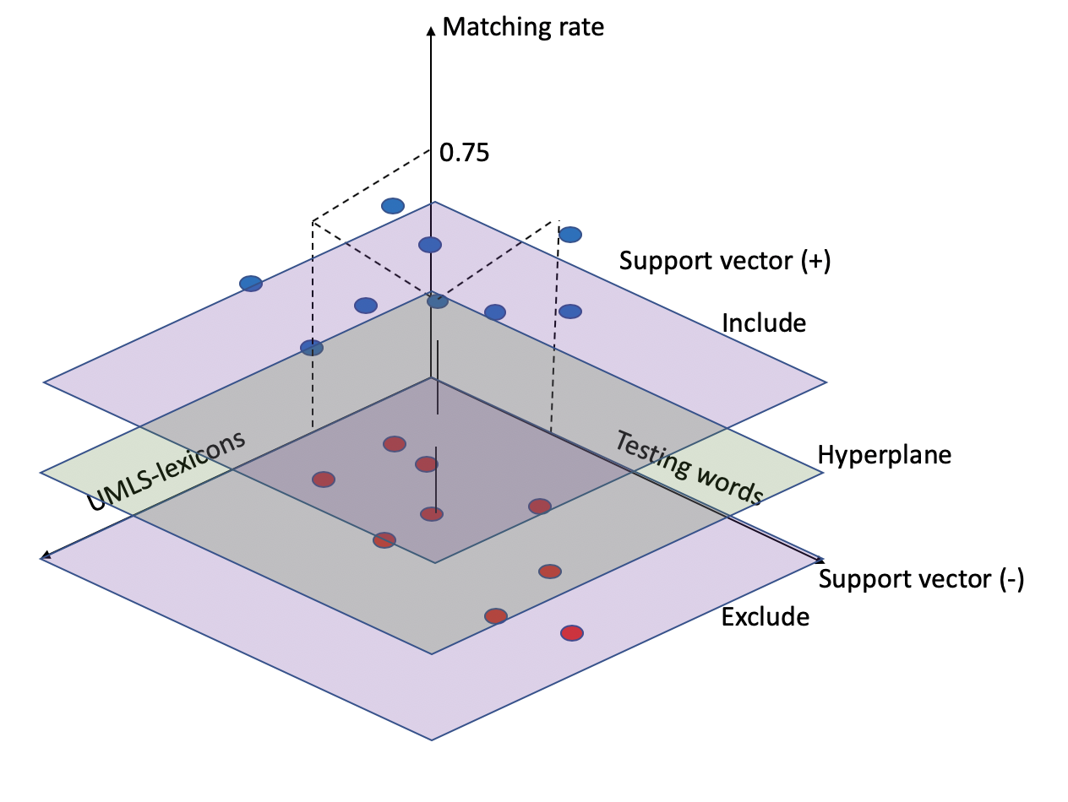
Discussion 1
Machine Learning approaches
Support Vector Machine algorithm
Every single word is tested for the matching rate against the terms in UMLS.
For example:
Testing word : squamous cell carcinoma UMLS : squamous cell carcinoma antigen 3 words are matching out of 4 → matching rate : 3 /4 = 0.75
Notes:
Support vector machine (SVM) is one of machine learning algorithms that analyzes data used for classification. In the figure, the x-axis refers to A to Z in alphabetical order and y-axis refers to the matching rate in range of 0 to 1. Hyperplane is drawn as an optimal output of given UMLS processed in algorithm to categorize new samples. The support vectors are generated at the closest points from hyperplane on each plus and minus sides which refer to word include and not include in final output.
The general process to calculate the matching rate is that when a sample word comes into the protocol, it is normalized and lemmatized, then compared to the word in hyperplane which is referred from UMLS lexicon. when a stemmed word has shorter letter length, the algorithm automatically generates random alphabets to fit the size. When counting the identical letters between the strings, it calculates the matching rate which is 87.5% in the example.
Ideally, the distance from hyperplane to the plus support vectors are minimized and the distance from hyperplane to the minus support vector is maximized to clarify the certain classification between includers and excluders.

Slide 20
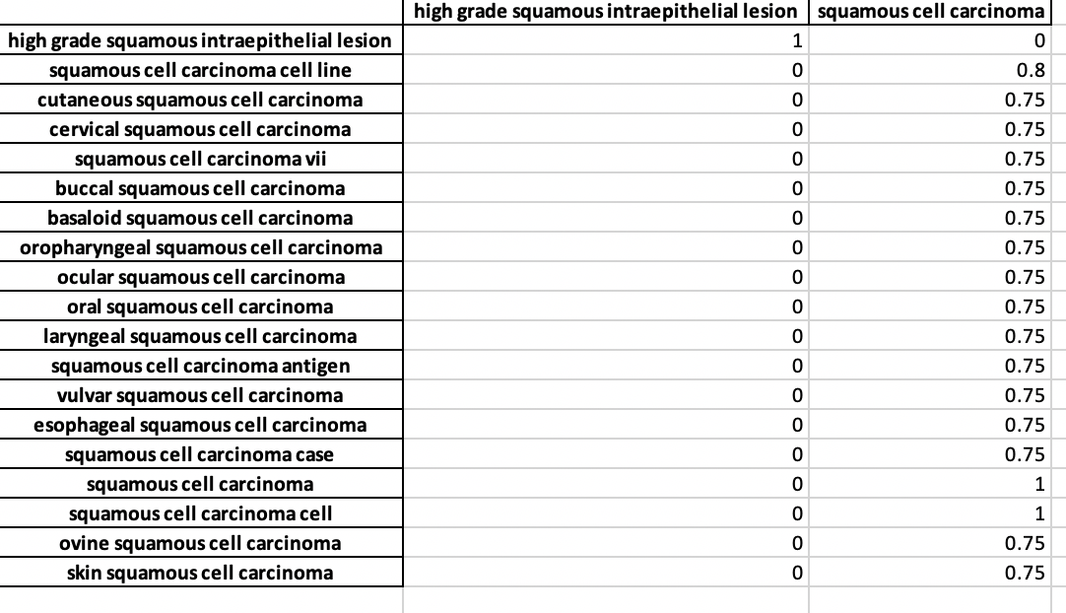
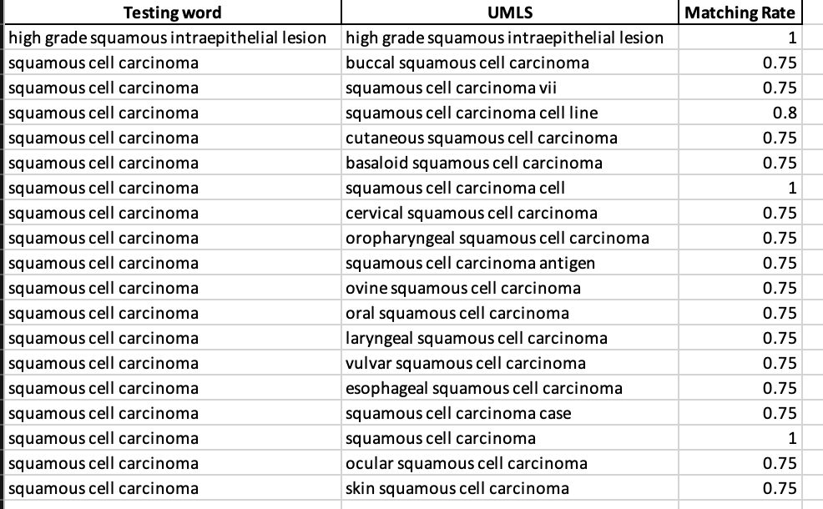
Normalized diagnosis description :
‘- At least high grade squamous intraepithelial lesion (CIN III) in a background of extensive necrosis, see comment. Comment : The specimen is predominately necrotic; however, there are small superficial fragments of severely dysplastic epithelium present. These findings are consistent with squamous cell carcinoma (unsampled)'
Words having matching rates greater or equal to 0.75
Notes:
In the practice, for example, I tested a sample of final diagnosis from an unidentified pathology report. I calculate the matching rates in algorithm and visualize it in Python. The blue line represents the UMLS lexicon-based hyperplane, the orange dashed line represents the plus support vector and lastly, the green dashed line represents the minus support vector. Counting the words whose points are above the plus support vector and extracting them, they are expected to represent the Final diagnosis of a certain body part and procedure.

Slide 21
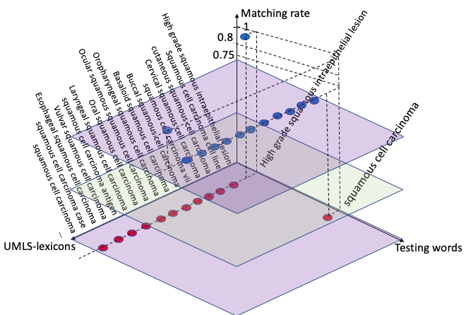
Normalized diagnosis description :
‘- At least high grade squamous intraepithelial lesion (CIN III) in a background of extensive necrosis, see comment. Comment : The specimen is predominately necrotic; however, there are small superficial fragments of severely dysplastic epithelium present. These findings are consistent with squamous cell carcinoma (unsampled)'
Notes:
In the practice, for example, I tested a sample of final diagnosis from an unidentified pathology report. I calculate the matching rates in algorithm and visualize it in Python. The blue line represents the UMLS lexicon-based hyperplane, the orange dashed line represents the plus support vector and lastly, the green dashed line represents the minus support vector. Counting the words whose points are above the plus support vector and extracting them, they are expected to represent the Final diagnosis of a certain body part and procedure.

Slide 22
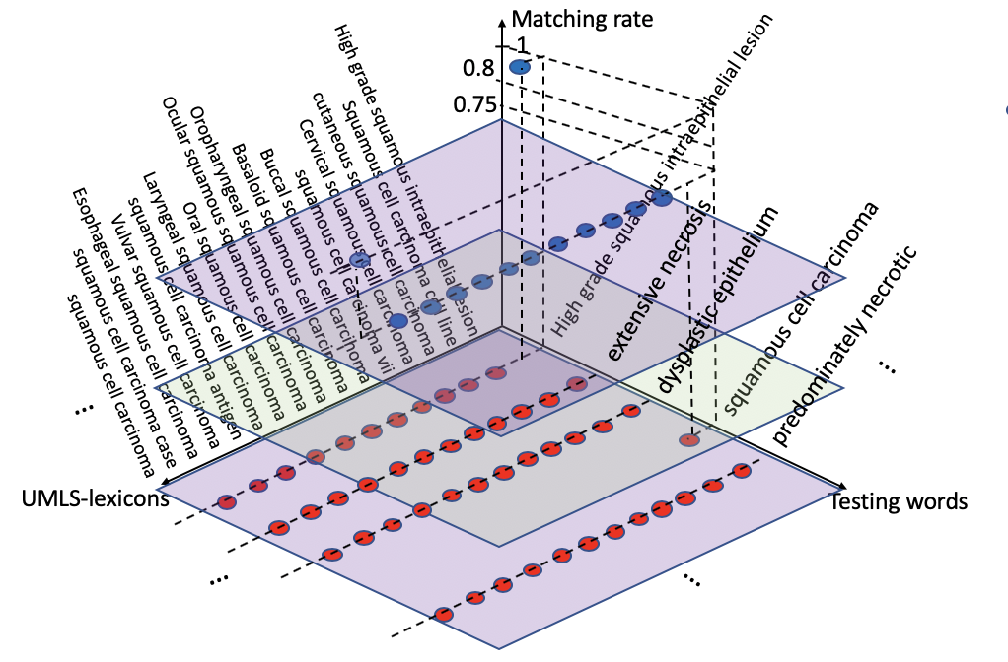

Slide 23
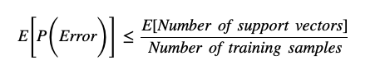
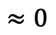
Where: E[P(Error)] = a measure of the test error of SVM E[Number of SV] = mean number of SV when permutation Number of training samples = number of permutation combinations
Calculating for the test error of SVM, less than percentage(2 / 20!) = 8.2206352e-19 of test error happened when extracting the important terms from a sample.
$$≈0$$
Not all patient’s information was able to be calculated in such way because some words have wrong spellings, wrong grammars, wrong hyphen uses between words and so on. → Keep the whole strings.
Gaonkar B, Davatzikos C. Deriving statistical significance maps for SVM based image classification and group comparisons. Med Image Comput Comput Assist Interv. 2012;15(Pt 1):723–730.

Slide 24
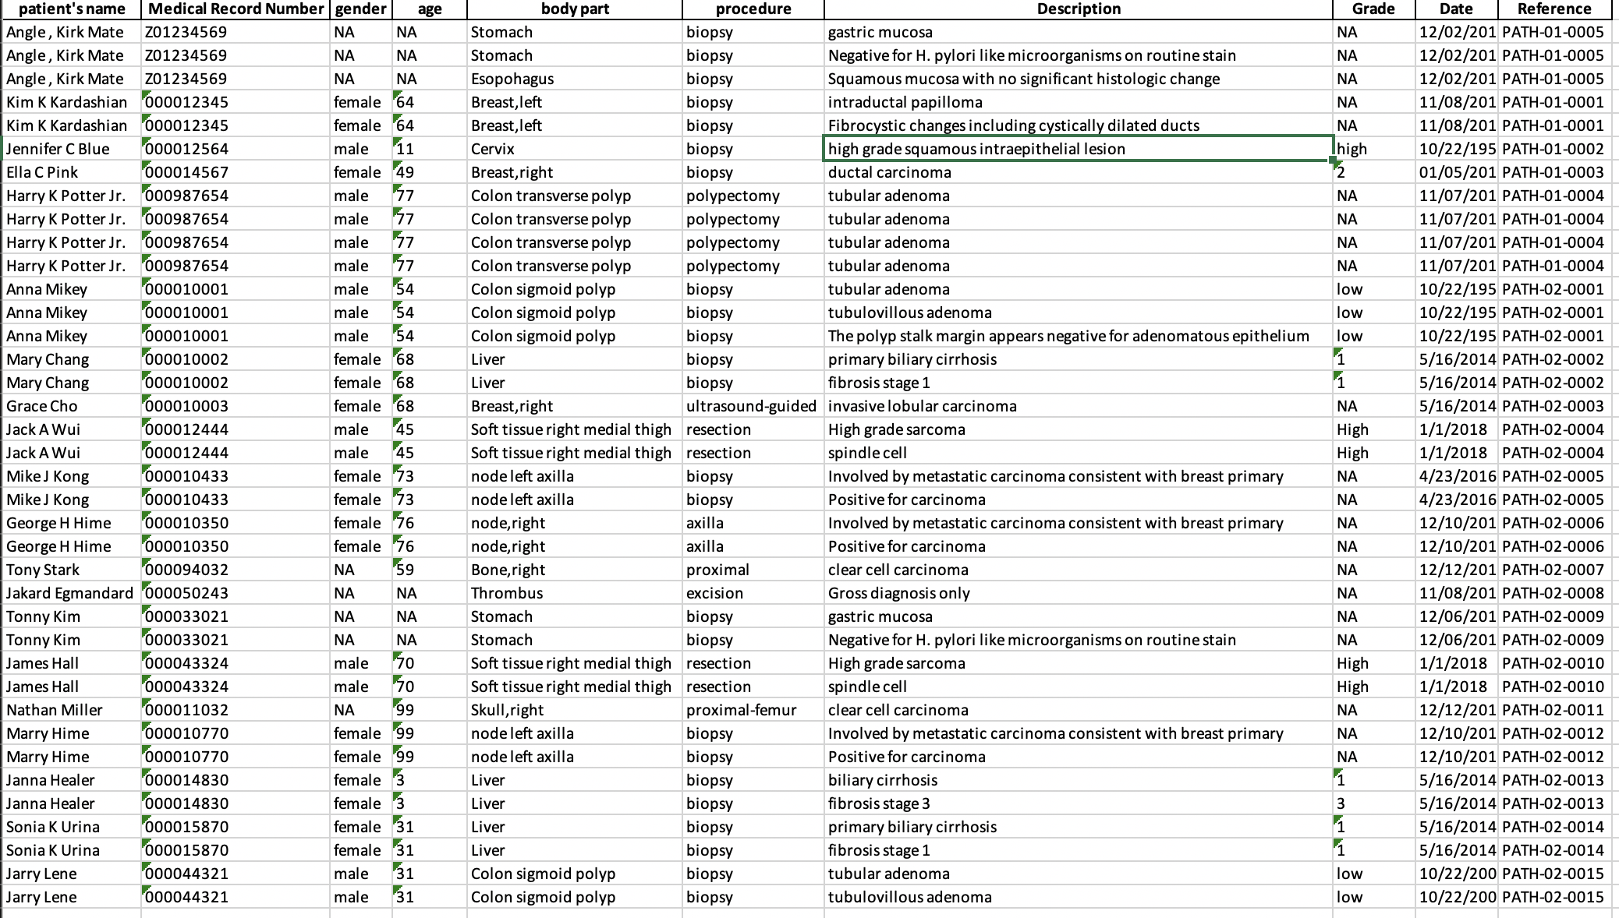
'… FINAL DIAGNOSIS : A. Cervix, biopsy: - At least high grade squamous intraepithelial lesion (CIN III) in a background of extensive necrosis, see comment. Comment : The specimen is predominately necrotic; however, there are small superficial fragments of severely dysplastic epithelium present. These findings are consistent with squamous cell carcinoma (unsampled) ...'
Since I assume that the comment section throughout all samples does not have important information, I excluded.
Notes:
Therefore, in the final result, it keeps the only words processed in the previous slide.

Slide 25
Procedures
Workflow 3
1. Extracting Note ID, Medical Record Number and age information from the
table on Half-way result.
2. Merging and Exporting the generated information in Excel

Slide 26
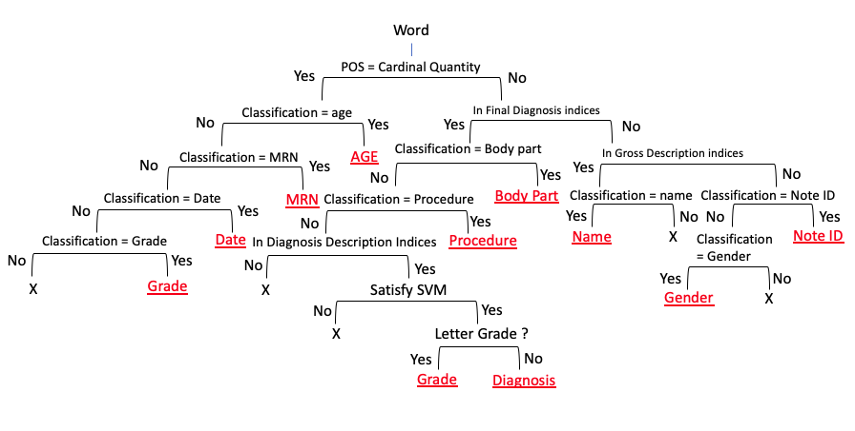
Discussion 2
Machine Learning approaches
Decision Tree algorithm
Notes:
For the entire protocol, it is designed following the decision tree. Each Red underlined represent the decisions. In the tree, the SVM is applied to figure out the diagnosis description.

Slide 27
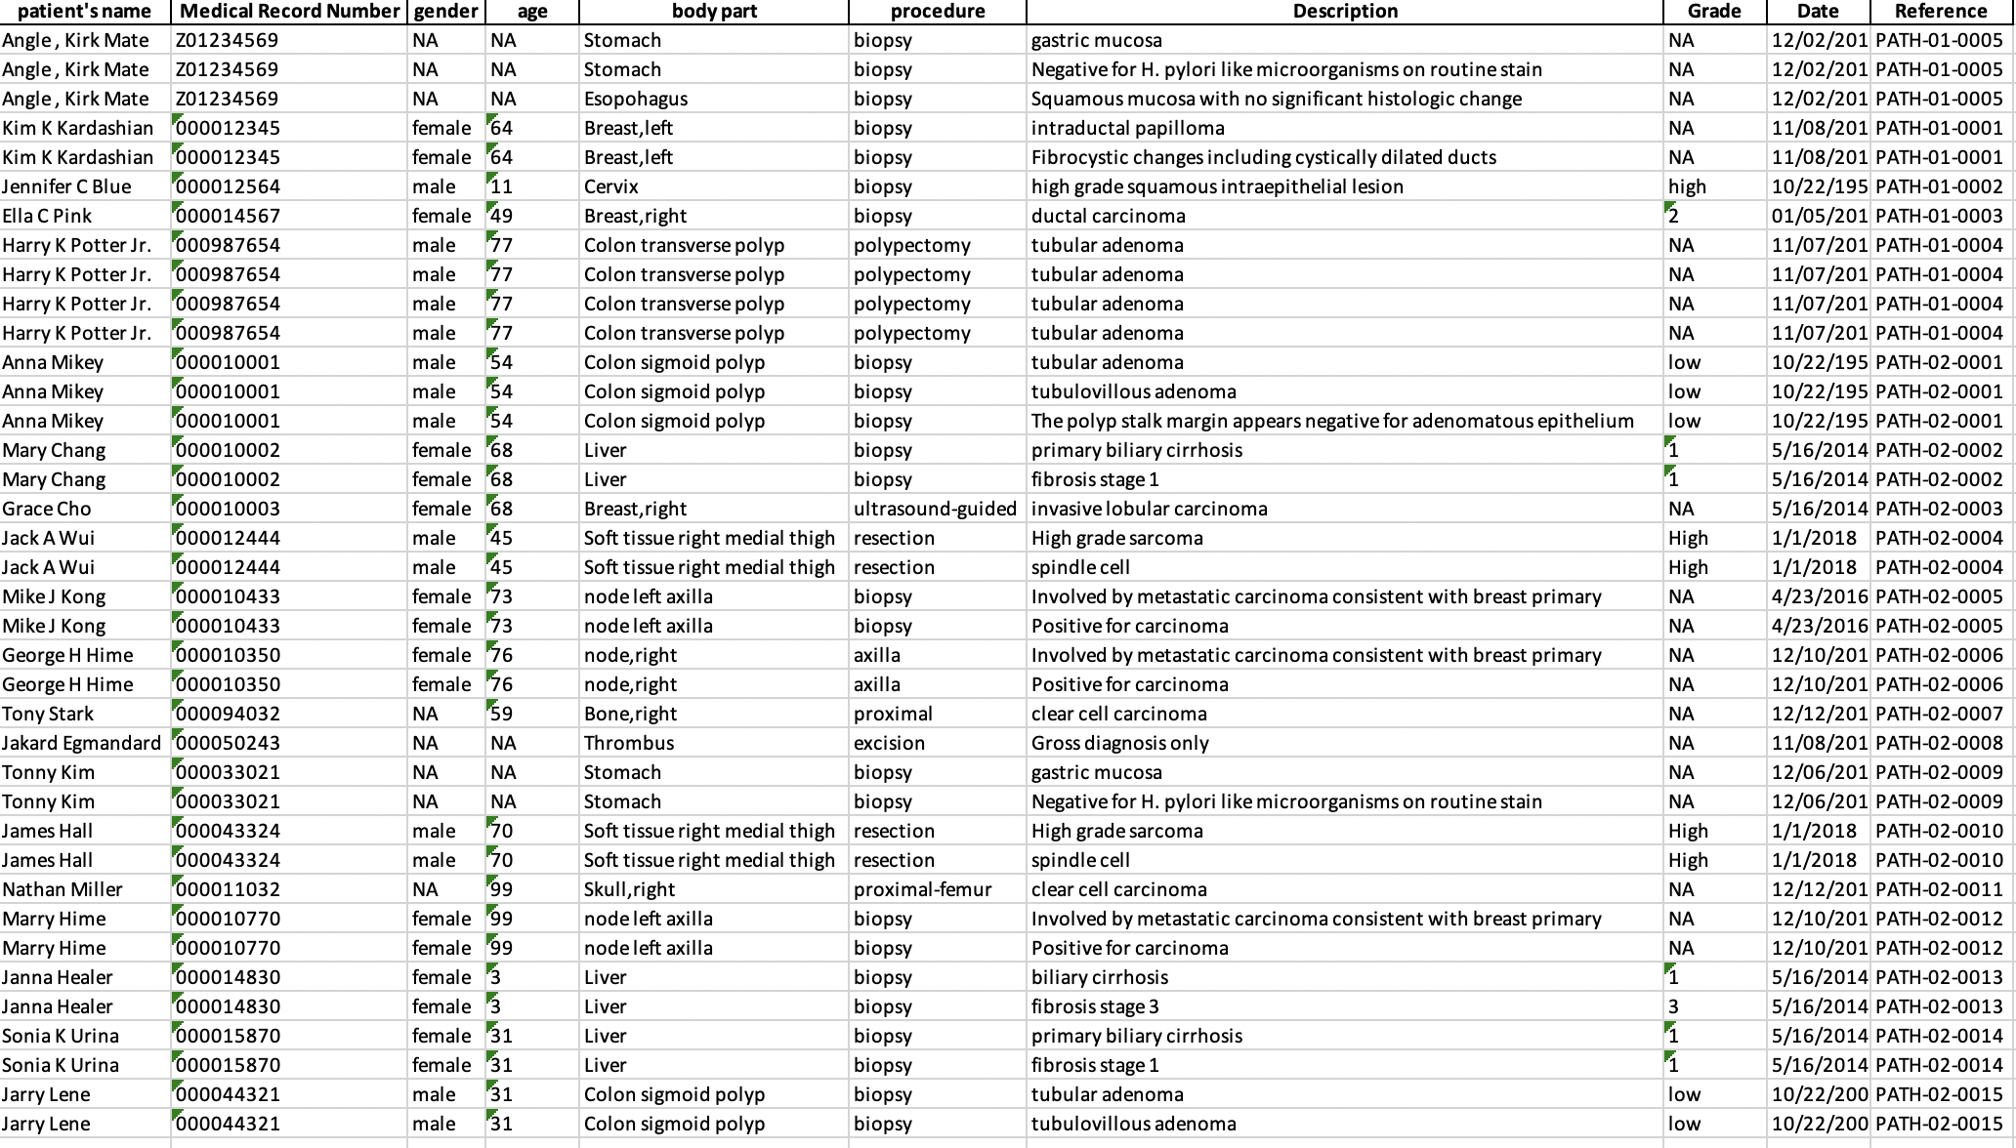
Final Result
Notes:
So, here is the outcome of processing 20 deidentified pathology report in the protocol.
The information extracted are patient’s name, Medical record number, age, body part, procedure, diagnosis description, grade of diagnosis, procedure date, and report note ID.

Slide 28
Challenge
The contents of the same type of reports are differently organized depending on patients’ diagnoses or the provider that entered the text. → The high variances of free-text
Notes:
After testing for 20 different Pathology reports within Python, the information are successfully extracted.
However, because the diagnosis sample dictionary which mainly work to extract diagnosis information is trained based on the new diagnosis appeared in samples, it still challenges to extract accurate and concise terms.

Slide 29
Conclusion
For the rapid adoption of the unstructured Electronic Medical Record, Natural Language Processing has been developed to extract important and dependable information from such free texts.
For this project, I applied Support Vector Machine and Decision Tree algorithms to automate the processing of large-scale data
For the result, I extracted patient’s name, MRN, gender, age, body part, procedure, diagnosis description, grade, date, and note ID.
Notes:
Through the Research internship program, it was truly good chance to improve myself. It was good opportunity to explore whole new and advanced field of my future career and to practice my knowledges from education. This program made me challenge to the advanced education and I will not miss this after graduation.

Slide 30
Acknowledgement
Ahmad Baghal, MD, MS, Director of TRI at UAMS
Shaymaa Al-Shukri, Ph D, Business Intelligence Analyst
Annu Kumari, Data Quality Analyst

Slide 31
References
Kavishwar B Wagholikar, Kathy L MacLaughlin, Michael R Henry, Robert A Greenes, Ronald A Hankey, Hongfang Liu, Rajeev Chaudhry, Clinical decision support with automated text processing for cervical cancer screening, Journal of the American Medical Informatics Association, Volume 19, Issue 5, September 2012, Pages 833–839, https://doi.org/10.1136/amiajnl- 2012-000820
Wang, Y., Wang, L., Rastegar-Mojarad, M., Moon, S., Shen, F., Afzal, N., … Liu, H. (2018). Clinical information extraction applications: A literature review. Journal of biomedical informatics, 77, 34–49. doi:10.1016/j.jbi.2017.11.011
Wall, M. (2014, March 04). Big Data: Are you ready for blast-off? Retrieved June 18, 2019, from https://www.bbc.com/news/business-26383058
KDnuggets. (n.d.). Retrieved June 21, 2019, from https://www.kdnuggets.com/2017/02/natural-language-processing-key-terms-explained.html
Ageitgey. (2019, January 02). Natural Language Processing is Fun! - Adam Geitgey. Retrieved June 21, 2019, from https://medium.com/@ageitgey/natural-language-processing-is-fun-9a0bff37854e
Kreimeyer, K., Foster, M., Pandey, A., Arya, N., Halford, G., Jones, S. F., . . . Botsis, T. (17 july 2017). Natural Language Processing Systems for Capturing and Standardizing Unstructured Clinical Information. Journal of Biomedical Informatics,1-16. doi:10.1016
Assale, M., Dui, L. G., Cina, A., Seveso, A., & Cabitza, F. (17 april 2019). The Revival of the Notes Field: Leveraging the Unstructured Content in Electronic Health Records. Frontiers in Medicine,1-23. doi:10.3389
Gaonkar B, Davatzikos C. Deriving statistical significance maps for SVM based image classification and group comparisons. Med Image Comput Comput Assist Interv. 2012;15(Pt 1):723–730.

